Slide 1
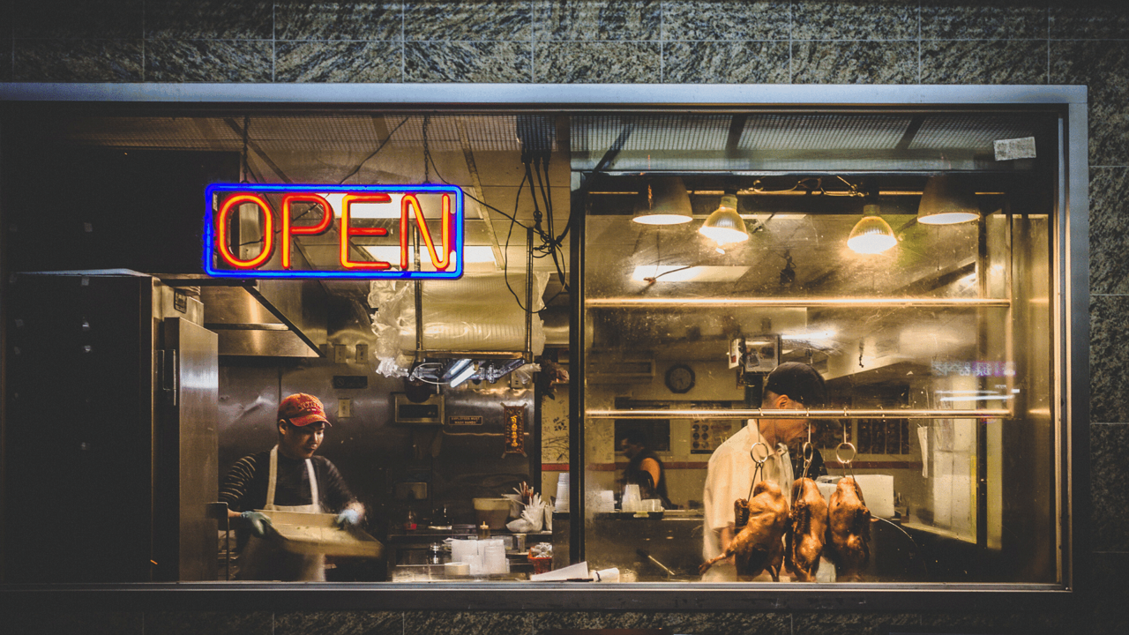
Finding the ideal neighborhood in London for opening a new Restaurant
Abhay Saini

Slide 2
A Valuable Guide for Restaurant Owners
London being one of the oldest and most prominent cities of the world, is a hotspot for real estate and opening of new businesses
Opening of a new restaurant in the city though is an exceedingly complex task, given the nature of the ethnic, geographic and other complexities
New Entrepreneurs experimenting with different cuisines as well as established franchise owners from across the world would love to know the neighborhoods where to open a new restaurant
Even City Planners would also appreciate the information as it would help them in re-designing the city optimally

Slide 3
Data Acquisition & Preparation
Most of the data is extracted from https://www.doogal.co.uk/london_postcodes.php and converted from Postcode level to Ward Level
Foursquare location data is also used, namely venue-categories information and likes count.
Total of 638 Rows in the Ward level Dataset and 32 rows in the District level, along with 8 columns
Location Data (Venues, Venue Category information) had around 13,270 rows in total, out of which 3,935 rows were left in the end (after selecting for only the restaurant categories). Later it was aggregated at Ward level
Final dataset had 499 rows and 15 columns.

Slide 4
Approach Followed
Exploratory Data Analysis in the beginning on both Ward and District Level
Extracting foursquare location data, sub-setting for Restaurant category
Aggregating initial data and foursquare location data (using one hot encoding, group by)
Clustering the neighborhoods on the final variables
Making sense of the clusters

Slide 5
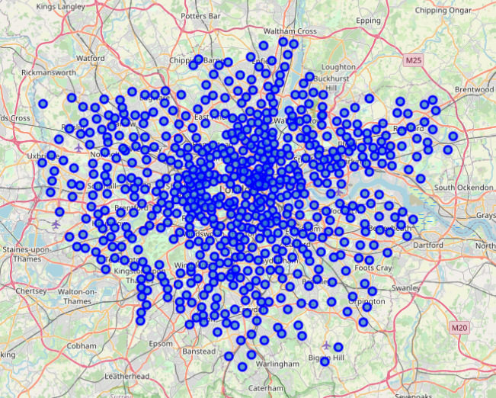
London Map plotted using Ward Coordinates

Slide 6
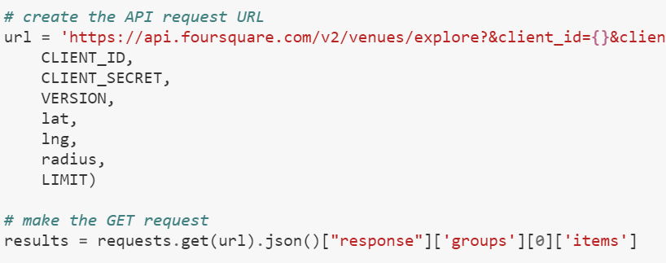
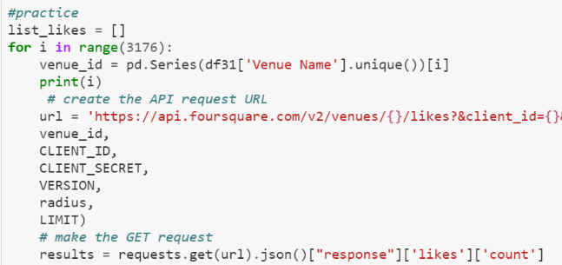
Foursquare Queries for extracting location data

Slide 7
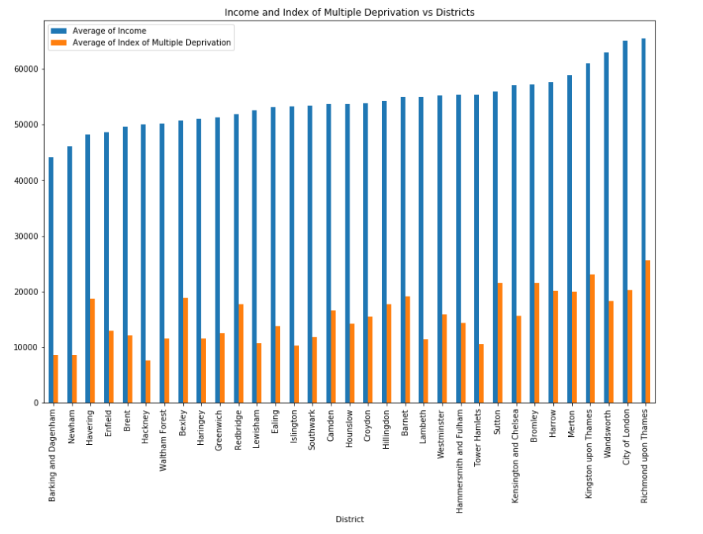
Average of Income and Index of Multiple Deprivation are highly correlated

Slide 8
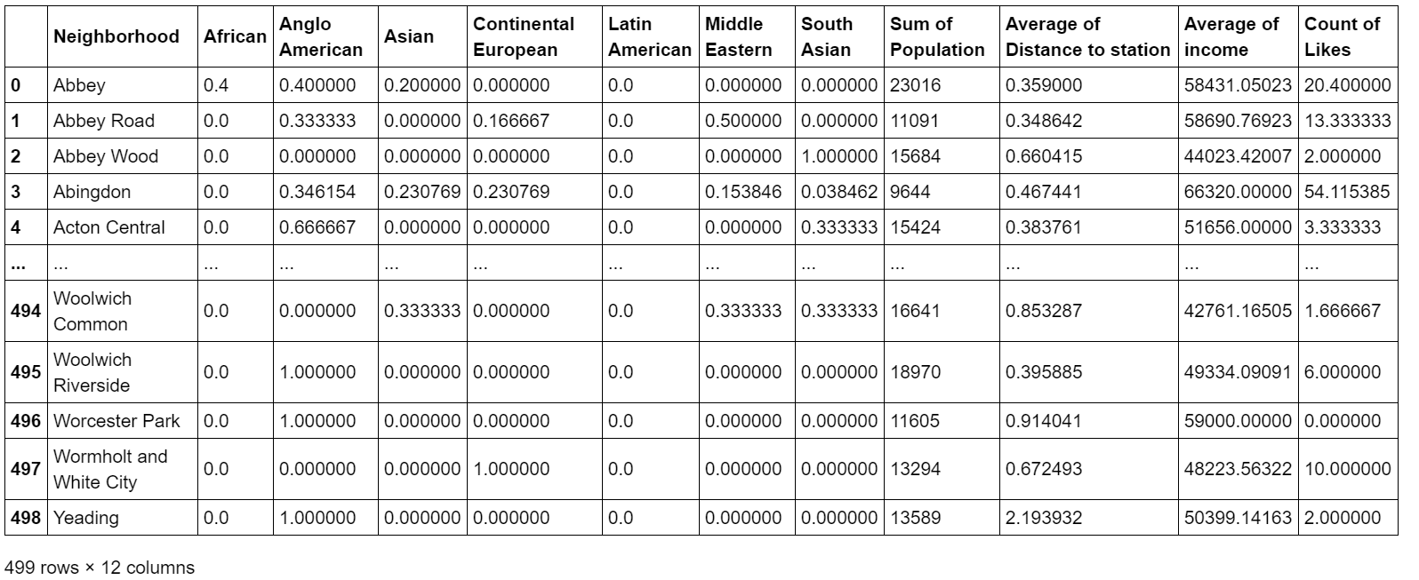
Visualizing the final snapshot

Slide 9
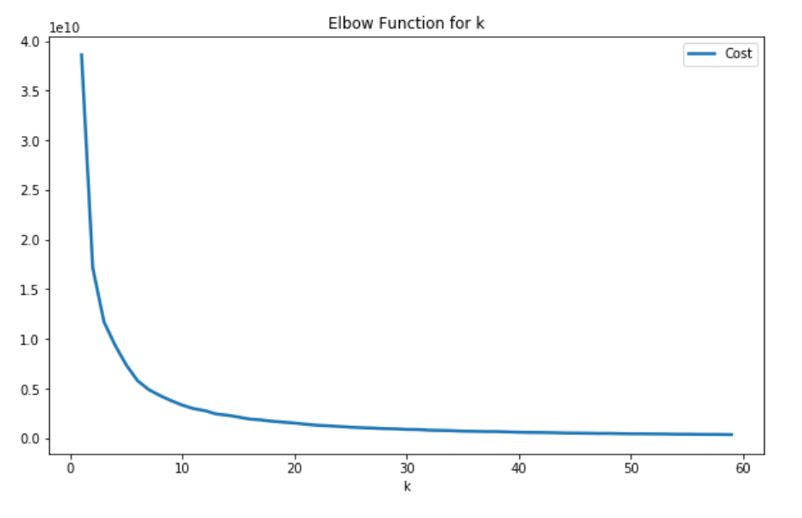
The Curve flattens at k ~ 40

Slide 10
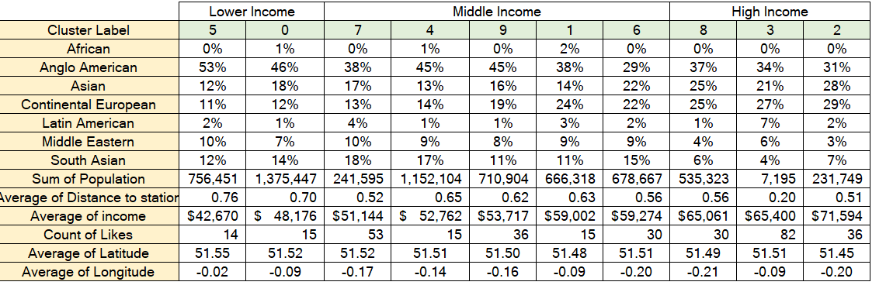
Cluster summaries for k=10

Slide 11
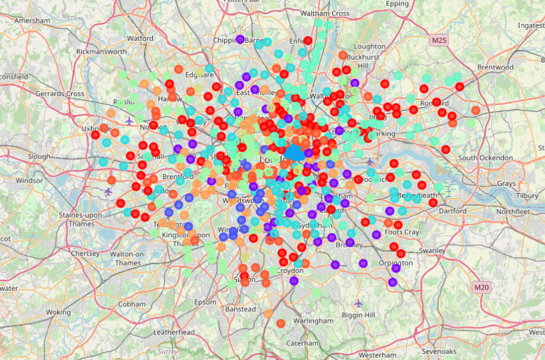
Visualizing the Clusters

Slide 12
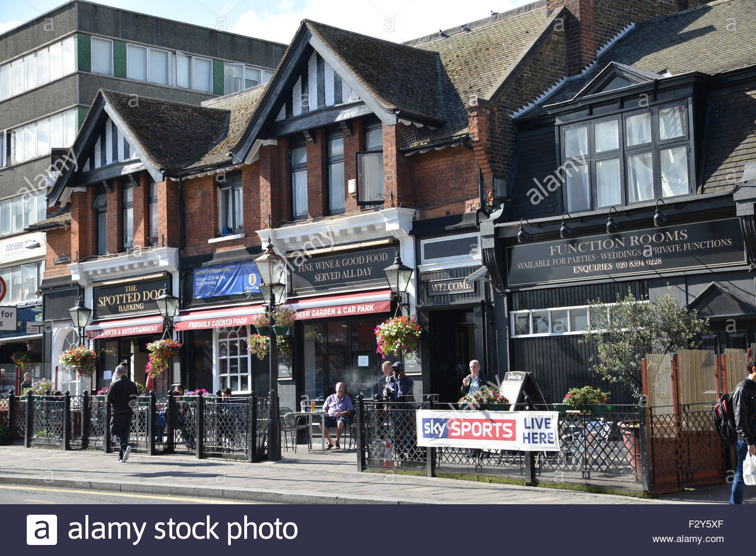
Making sense of the Results : Low Income Neighborhood Cluster
For k=10, the results could be divided into 3 separate collections of clusters.
Clusters 5 and 0 could be called “Low Income Neighborhoods”
High Traditional Anglo-American Places
Less Ethnic Eating Places (Except for Middle Eastern)
High Distance to Station
Not very liked on Social Media either

Slide 13
Making sense of the Results : Middle Income Neighborhood Cluster
Clusters (7,9,1,4,6) are in the “Middle Income Neighborhoods”
Comparatively higher number of Ethnic Eateries
Cluster 7 and 4 are highest in South Asian cuisine and are well liked on Social Media (reflecting highly active South Asian population on Social Media). Cluster 7 is high in Latin American too
9 is almost like 4 with the exception of South Asian and Asian-European exchanging places
1 is a higher end Middle Income neighborhood with a drastic increase in Continent European
6 shows a drop in traditional Anglo American and a steep rise in Asian, along with Continental European

Slide 14
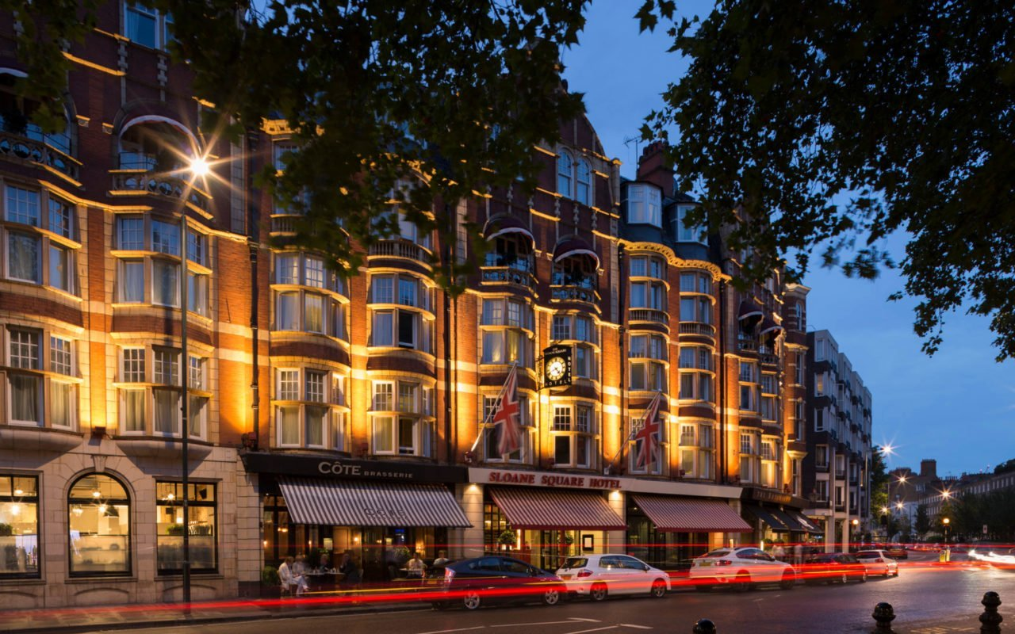
Making sense of the Results : High Income Neighborhood Cluster
Clusters (2,6,8) are in the “High Income Neighborhoods”
Among the high income, 3 is unique in the sense that it has a low population and the highest Latin American % (7%)
2 has the highest Asian and Continental European as well as the highest income and is highest liked neighborhood in terms of likes)
8 has less ethnic (south Asian and Latin) varieties and fair number of others

Slide 15
Discussion/Alternative Approaches
Other Potential Variables/Approaches
Police Coverage/Crime Rate
Density of Restaurants
Uber/Ola Service in the Neighborhood
Age of the Residents
Instead of Clustering, we could run a linear regression and predict the sales of a new restaurant in a particular neighborhood.
We could have used a more detailed and comprehensive clustering of k = 40

Slide 16
Conclusions
For opening a Working Class Restaurant: -
If it’s Asian/South Asian, choose the 101 Neighborhoods in Cluster 0
If it’s generic/Anglo-American, choose the 55 Neighborhoods of Cluster 5
For opening Middle Class Restaurant: -
If it’s South Asian, choose the 9 Neighborhoods of Cluster 7th or the 76 Neighborhoods of Cluster 4
If it’s Continental European, choose the 41 Neighborhoods of Cluster 1
If it’s Asian, choose the 63 Neighborhoods of Cluster 6
If it’s Anglo-American, choose the 64 Neighborhoods of Cluster 9
For opening High End Restaurant: -
If it’s Asian or Continental European, Choose the 20 Neighborhoods of Cluster 2
If it’s Latin American, choose the 24 Neighborhoods of Cluster 3
If it’s a Generic, choose the 46 Neighborhoods of Cluster 8

Slide 17
Thank You

Slide 18
Appendix

Slide 19
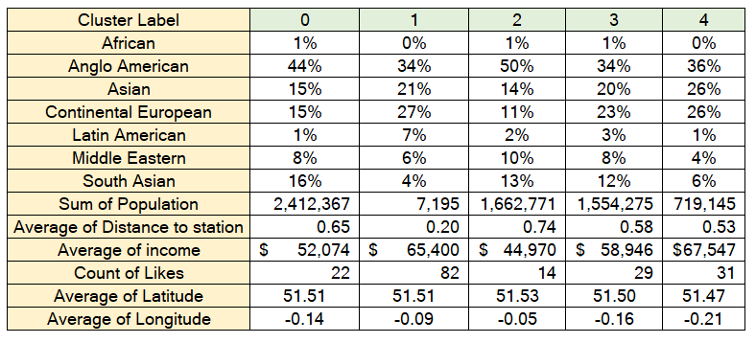
Cluster summaries for k=5

Slide 20
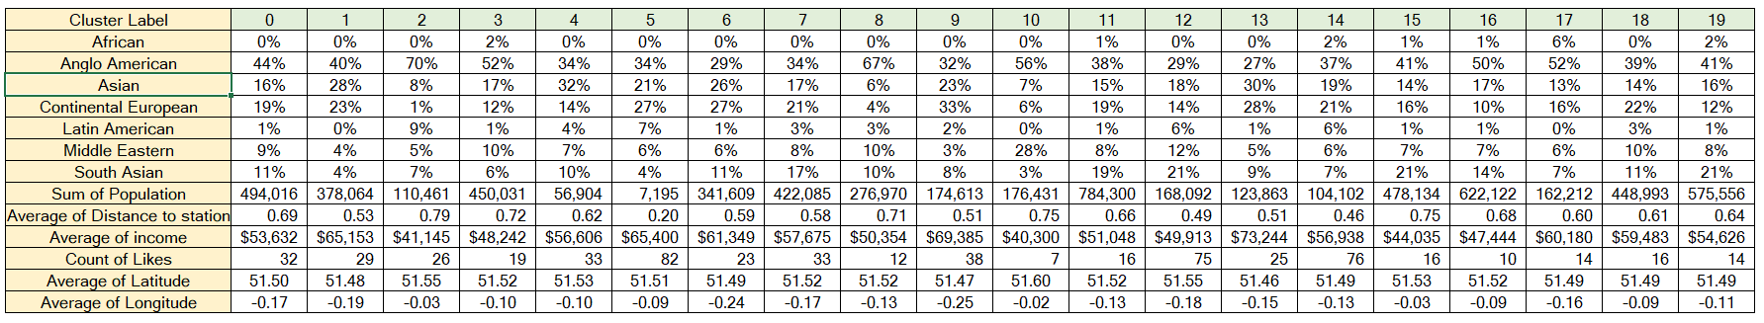
Cluster summaries for k=20

